Slide 1














HACKSAGON-2020 Project Presentation
Project Category: Any Other or Software (AO)
Theme: Health & Environment Related Devices
CoronaVirus Outbreak in India –
A Programming based Solution
Team Name: Ayushman
Team Leader Name: Ayushman Singh Chauhan
Institute Name: Indian Institute of Information Technology Guwahati
AdvanceTech India Pvt. Ltd.

Slide 2
Outline
Introduction
Objectives
Components Used / Type of Coding
Methodology/Code
Importance for Society
Expected Outcomes of the Idea
Progress So Far
References

Slide 3
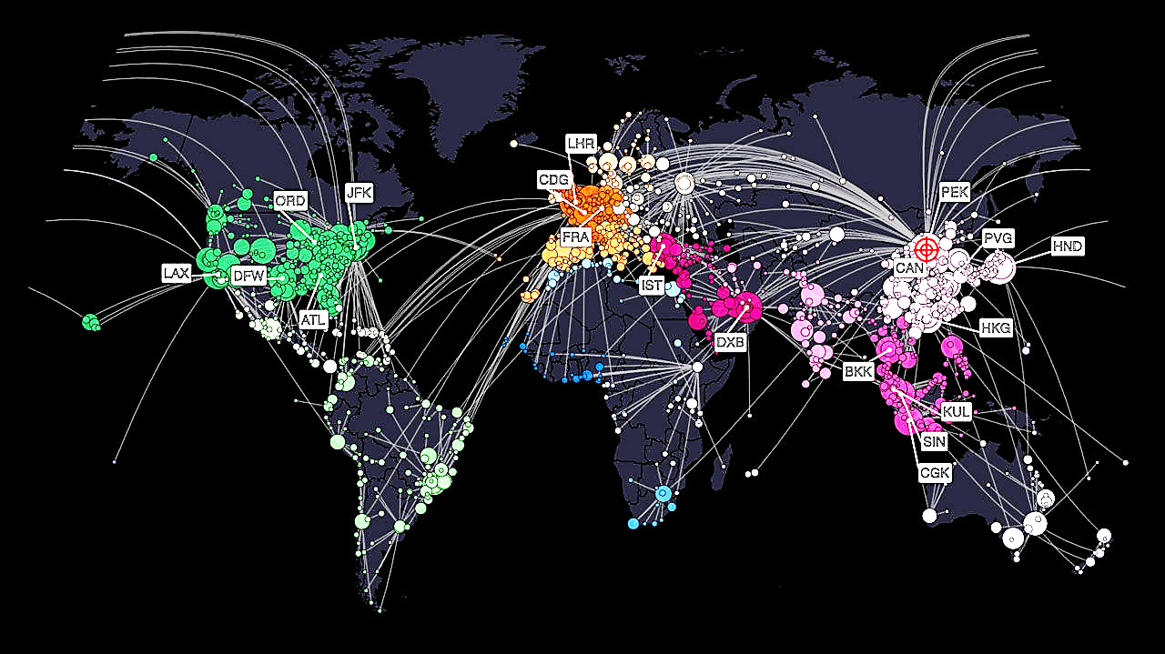
Introduction
Let’s see the Current Stats
Region | India | World
Deaths | 5 | 12,948
Cases | 329 | 301,100
New Cases | 80 | 25,553
Recovered | 23 | 94,625

Slide 4
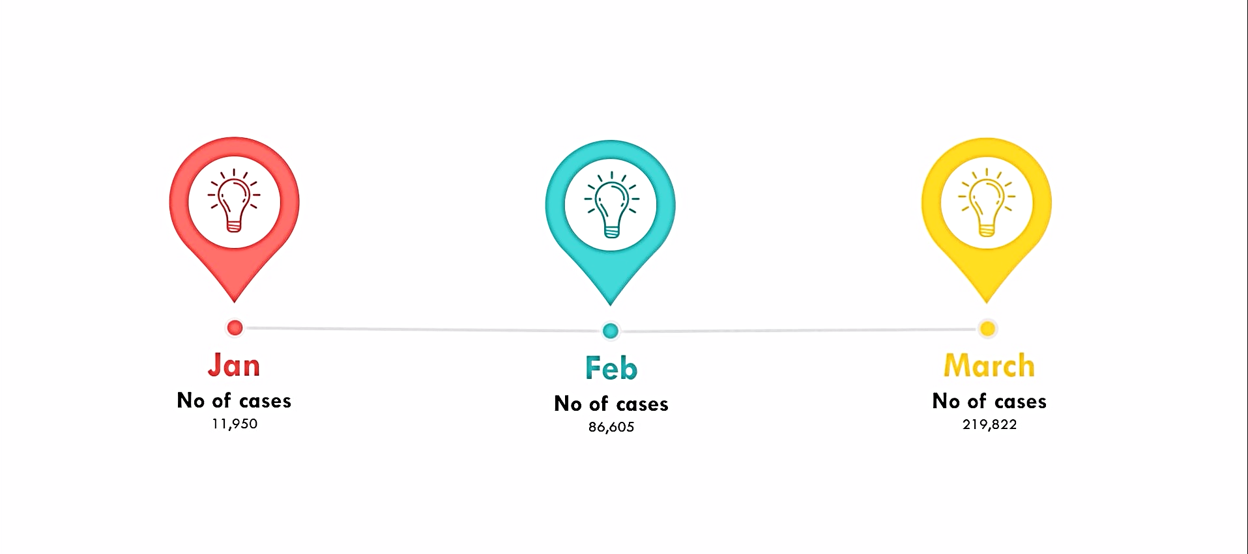
Scary growth of COVID-19

Slide 5

Objectives
The Objective is to Stop the transmission by prioritizing tests and hence detecting the cases quickly
Data can be collected on the symptoms of COVID-19
A machine learning model is then trained on the data to find out the probability of a person having the infection
The model is then used to find out whom to test for the infection first under a limited testing capacity
The same model can be used to find potential candidates for conducting random tests

Slide 6
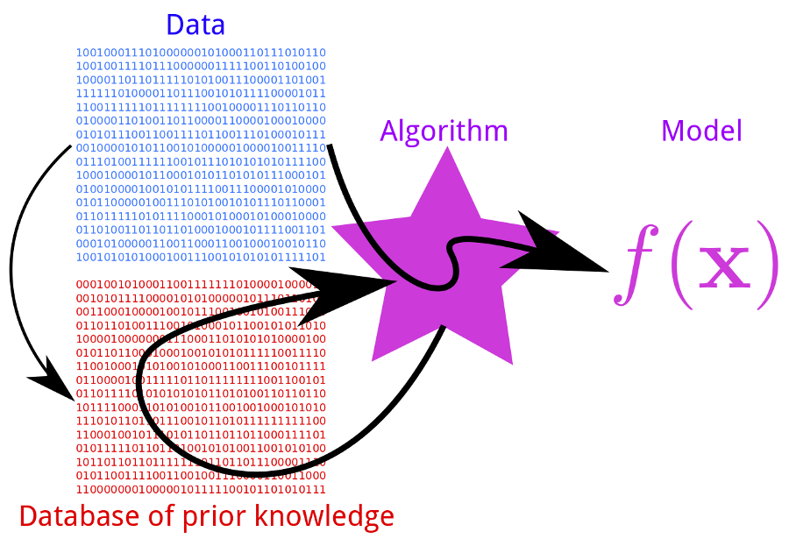
Components Used/Type of Coding
Machine learning model parameters
A team of doctors can sit down to find out the best model parameters.
A sample set of such parameters is as follows:
Features
Average fever: Continuous
Body pain: 0/1(Binary)
Age: Discrete
Runny Nose: 0/1(Binary)
Difficulty Breathing – categorical: -1/0/1
Labels:
Probability of COVID – 19 Infection

Slide 7


Methodology/Code
COVID-19 Detector is an interactive Web Application powered by Python.
JuPyter notebook is Used for the initial Development
By training the Database and import the machine learning model into a HTML file with the Flask (web framework).
Data to be randomly generated for this Prototype
My Model use pandas, numpy and sklearn.linear_model ,these are libraries for machine learning in Python, to train and run the model in the web browser.
This model uses a technique called Logistic regression.
A HTML file will contain the UI with a form capable of sorting inferring the input data from the trained model

Slide 8

Importance for Society
To aid people by providing them knowledge through a Web Application has not been done yet.
Technologies that were made to convert information so that it can be accessible to computers are used to aid people and I can contribute to a social cause.

Slide 9
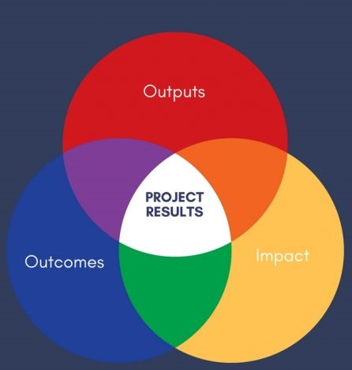
Expected Outcomes
This model allows better priority to certain people who are affected by the virus.
Understand the important effect that technology has on the medical facility today.
Right now I have designed the project for One Disease but it can be designed for more number of diseases.
It acts as a life saving device.
All the tools and technologies used for developing COVID-19 detector are free hence the cost of production and development is close to NULL.
All COVID-19 detector required is an internet connection which makes it affordable for everyone.

Slide 10
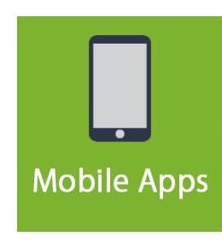

Progress So Far
This project is a Web Application (web-based) and I will convert it into an Android App(I am on it) !!
User can access this facility by Smartphone also since this model is embedded into website and the website is live.

Slide 11
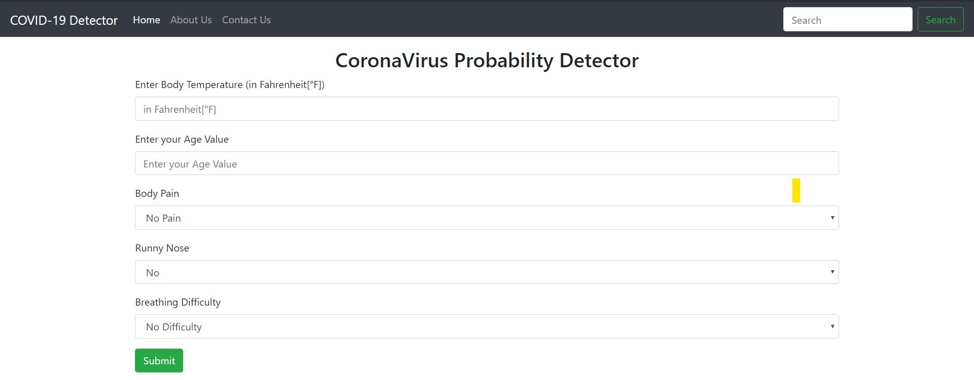
Gallery

Slide 12
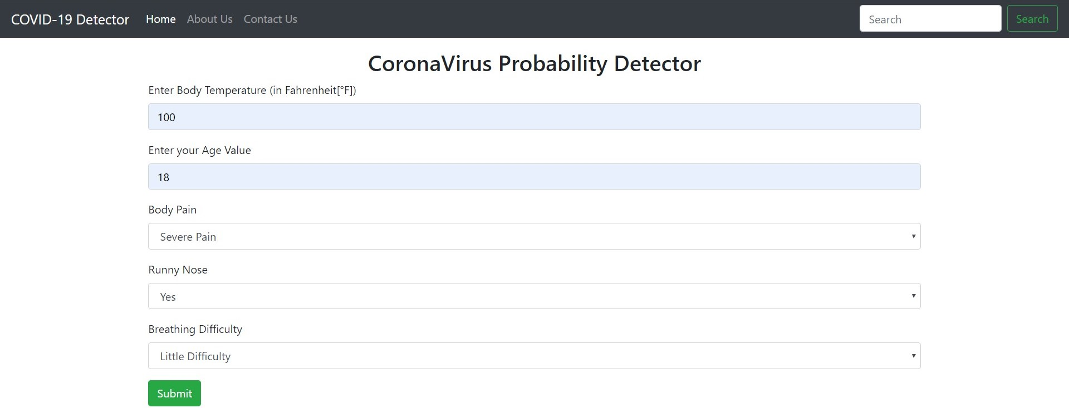
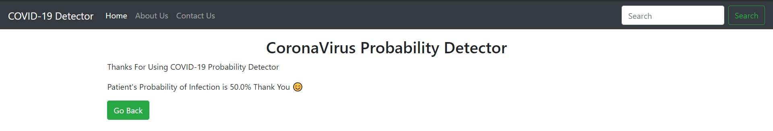

Slide 13
References
https://www.worldometers.info/coronavirus/
YouTube
Google
Other links:
● My project Repository</>
● Launch my Project

Slide 14
Thank You

